Slide 1
Data Structures and Algorithms
Sorting Techniques

Slide 2
Sorting
Sorting is used to arrange names and numbers in meaningful ways.
Sorting Techniques
Bubble sort
Selection sort
Insertion sort
Shell Sort
Quick sort
Merge sort
Heap sort

Slide 3
Sorting Operations
Comparison
Test whether Ai < Aj or test Ai < B.
Interchange
Switches the contents of Ai and Aj or Ai and B.
Assignments
Set B = A and then set Aj = B or Aj = Ai.

Slide 4
Bubble Sort
Each element is compared with its adjacent element. If the first element is larger than the second one, then the positions of the elements is interchange, otherwise it is not changed. Then the next element is compared with its adjacent element and the same process is repeated for all the elements in the array until the array is sorted.

Slide 5
Illustration (Bubble sort)
Given: A[ ] = { 35, 10, 55, 20, 5 };

Slide 6
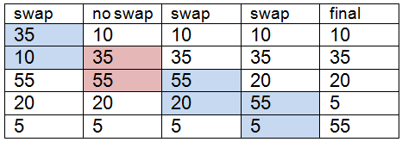
Illustration (Bubble sort)
First Pass

Slide 7
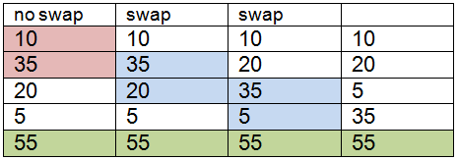
Illustration (Bubble sort)
Second Pass

Slide 8
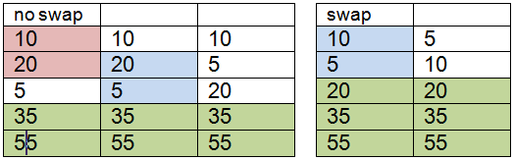
Illustration (Bubble sort)
Third Pass
Fourth Pass

Slide 9
Algorithm (Bubble sort)
Let A be a linear array of n numbers, swap is temporary variable for swapping (or interchange) the position of the numbers.

Slide 10
Algorithm (Bubble sort)
input n numbers of an array A
initialise i equal to 0 and repeat through sub steps if i is less than n
initialise j equal to 0 and repeat through sub steps if j is less than n – 1
do sub steps if A[j] is greater than A[j+1]
assign A[j] to swap
assign A[j+1] to A[j]
assign swap to A[j+1]
display the sorted numbers of array A
exit

Slide 11
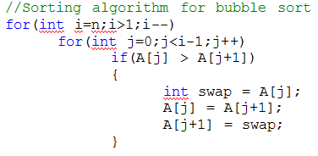
Bubble sort

Slide 12
Selection Sort
Finds the smallest element of the array and interchange it with the element in the first position of the array. Then it finds the second smallest element from the remaining elements in the array and places it in the second position of the array and so on.

Slide 13
Illustration (Selection sort)
Given: A[ ] = { 30, 40, 20, 50, 10 };

Slide 14
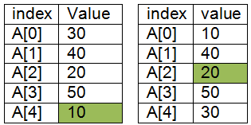
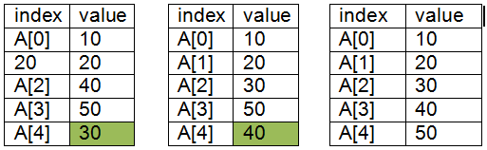
Illustration (Selection sort)
1st Pass
2nd Pass
3rd Pass
4th Pass

Slide 15
Algorithm (Selection sort)
Let A be a linear array of n numbers, min is the variable to store smallest number and index is the index location of the smallest element of the array.

Slide 16
Algorithm (Selection sort)
input n numbers of an array A
initialise i equal to 0 and repeat through sub steps if i is less than n – 1
assign A[i] to min
assign i to index
initialise j equal i plus 1 and repeat through sub steps if j is less than n
do the sub steps if A[j] is less than min
assign A[j] to min
assign j to index
increment the value of j
assign A[i] to A[index]
assign min to A[i]
increment the value of i
display the sorted numbers of array A
exit

Slide 17
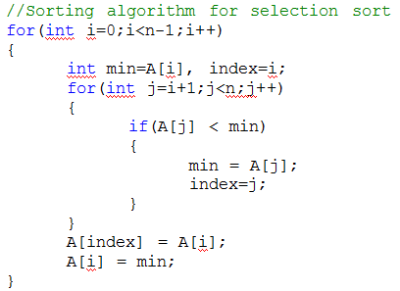
Selection sort

Slide 18
Insertion Sort
Sort a set of values by inserting values into an existing sorted file.
Compare the second, place it before the first one. Otherwise place it just after the first one.
Compare the third value with the second. If the third value is greater than the second value then place it just after the second. Otherwise place the second value to the third place.
And compare third value with the first value. If the third value is greater than the first value place the third value to second place, otherwise place the first value to second place.

Slide 19
Illustration
Given: A[ ] = { 40, 30, 20, 50, 10 };

Slide 20
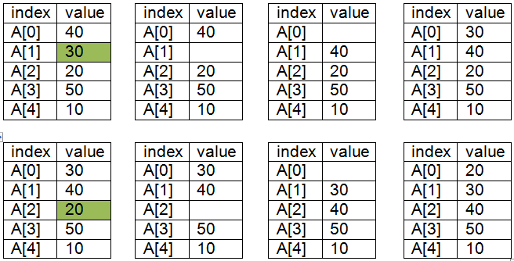
Illustration
1st Pass
2nd Pass

Slide 21
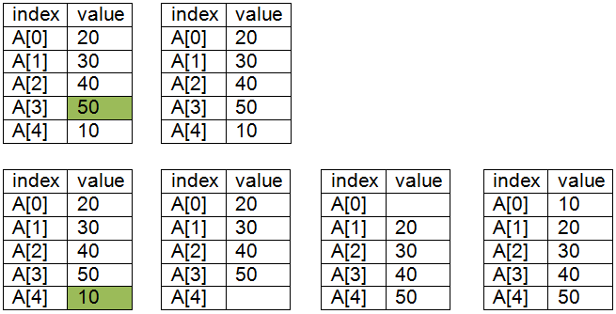
Illustration
3rd Pass
4th Pass

Slide 22
Algorithm
Let A be a linear array of n numbers, temp is temporary variable for swapping (or interchange) the position of the numbers.

Slide 23
Algorithm
input n numbers of an array A
initialise i equal to 1 and repeat through sub steps if i is less than n
assign A[i] to temp
initialise j equal i minus 1 and repeat through sub steps if j is greater than or equal to 0 and temp is less than A[j]
assign A[j+1] to A[j]
decrement the value j
assign A[j+1] to A[j]
increment the value of i
display the sorted numbers of array A
exit

Slide 24
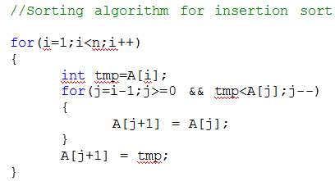
Insertion Sort

Slide 25
Shell Sort
The Shell sort is named after its inventor, Donald Shell, who published the algorithm in 1959.
Shellsort is a sequence of interleaved insertion sorts based on an increment sequence.
The increment size is reduced after each pass until the increment size is 1.

Slide 26
Shell Sort
Given: A[ ] = { 40, 30, 20, 50, 10 };
Increment = #of elements / 2
1ST PASS; INCREMENT= 2
List 1: {40, 20, 10}
List 2: {30,50}
Perform Insertion Sort for each list
List 1: {10, 20, 40}
List 2: {30,50}

Slide 27
Shell Sort
New: A[ ] = { 10, 30, 20, 50, 40 };
increment= increment / 2
2nd PASS; INCREMENT= 1
Perform Insertion Sort if increment == 1
A[ ] = { 10, 20, 30, 40, 50 };

Slide 28
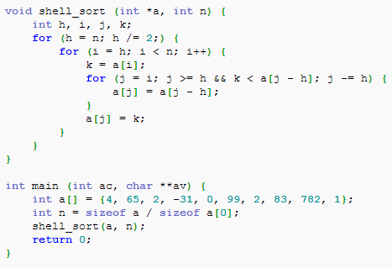
Shell Sort

Slide 29
Merge Sort
Is a divide and conquer algorithm
Is the process of combining two or more sorted array into a third sorted array. It was one of the first algorithms used on a computer and was developed by John Von Neuman.
Divide the array into approximately n/2 sub-arrays of size two and set the element in each sub array. Merging each sub-array with the adjacent sub-array will get another sorted sub-array of size four. Repeat this process until there is only one array remaining of size n.

Slide 30
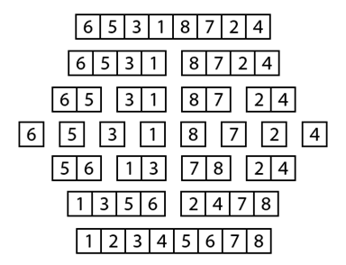
Illustration

Slide 31
Algorithm
Let A be a linear array of size n, A [1], A [2], A [3] ...... A [n], l1 and u1 represent lower and upper bounds of the first sub-array and l2 and u2 represent the lower and upper bound of the second sub-array. Aux is an auxiliary array of size n. Size is the sizes of merge files.

Slide 32
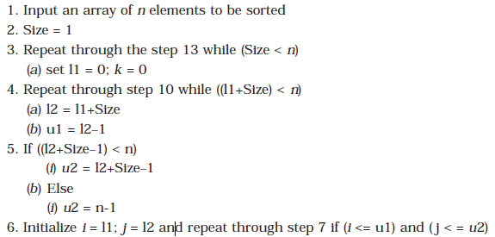
Algorithm

Slide 33
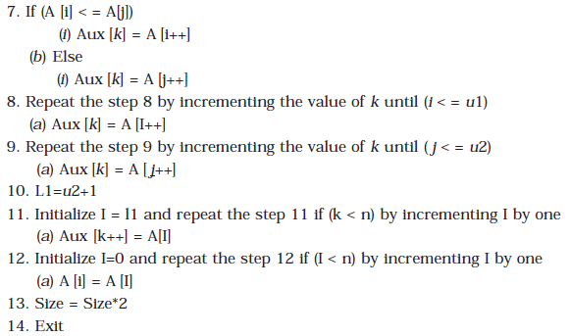
Algorithm

Slide 34
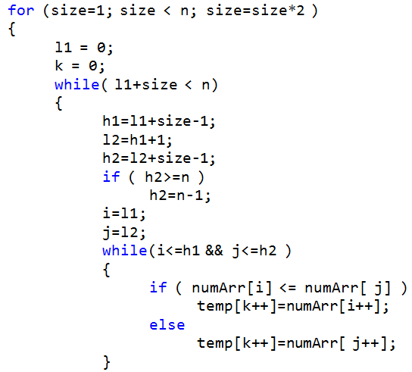
Merge sort without recursion

Slide 35
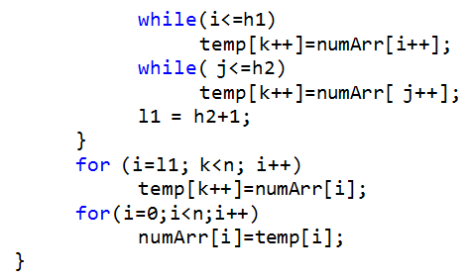

Slide 36
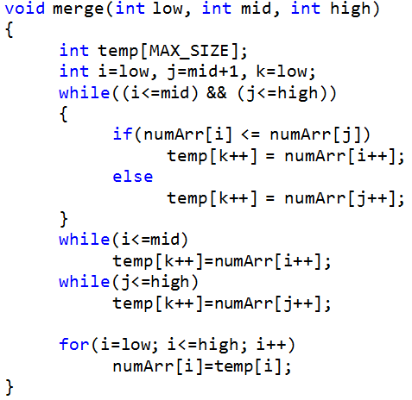
Merge sort with recursion

Slide 37
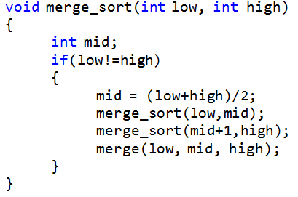
Merge sort with recursion

Slide 38
Quick Sort
Developed by Tony Hoare
Arranges elements of a given array A[0..n-1) to achieve its partition, a situation where all the elements before some position s are smaller than or equal to A[s] and all the elements after position s are greater than or equal to A[s]:
A[0]…A[s-1] A[s] A[s+1]…A[n-1]
all are <= A[s] all are >= A[s]

Slide 39
Quick Sort
Select a pivot (partitioning element) – here, the first element
Rearrange the list so that all the elements in the first s positions are smaller than or equal to the pivot and all the elements in the remaining n-s positions are larger than or equal to the pivot (see next slide for an algorithm)
Exchange the pivot with the last element in the first (i.e., ≤) subarray — the pivot is now in its final position
Sort the two subarrays recursively
p
A[i]≤p
A[i]≥p

Slide 40
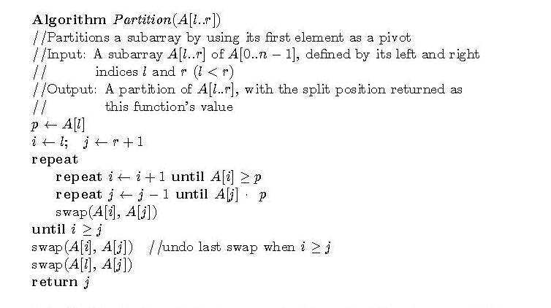
Partitioning Algorithm

Slide 41
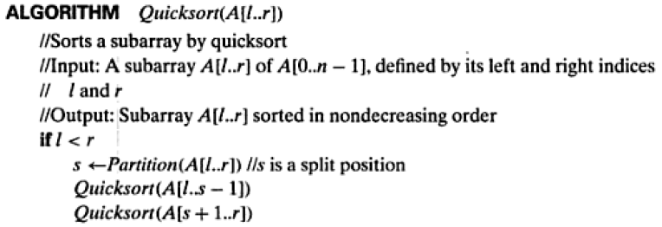
Quicksort Algorithm

Slide 42
Example
5 3 1 9 8 2 4 7
2 3 1 4 5 8 9 7
1 2 3 4 5 7 8 9
1 2 3 4 5 7 8 9
1 2 3 4 5 7 8 9
1 2 3 4 5 7 8 9

Slide 43
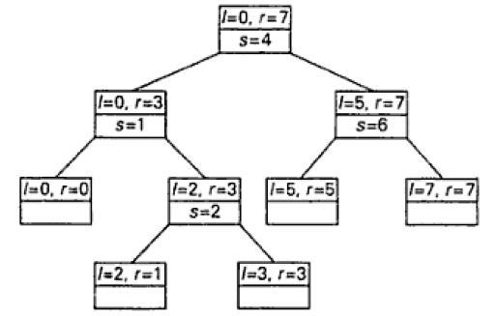
Recursive calls to Quicksort

Slide 44
Heap Sort
A heap is defined as an almost complete binary tree of n nodes such that the value of each node is less than or equal to the value of the father

Slide 45
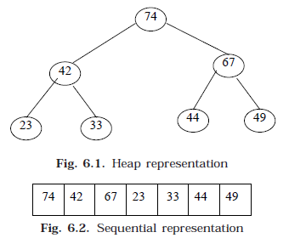
A Heap

Slide 46
Inserting an Element to a Heap
Consider the heap H. Add a data = 55 to H

Slide 47
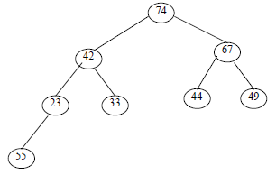
Step 1: Adjoin 55 as the next element in the complete tree. Find the appropriate place for 55 in the heap by rearranging it.

Slide 48
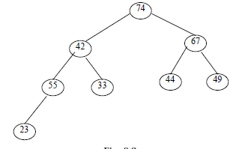
Step 2: Compare 55 with its parent 23. since 55 is greater than 23, interchange 23 and 55.

Slide 49
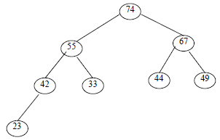
Step 3: Compare 55 with its parent 42. Since 55 is greater than 42, interchange 55 and 42.

Slide 50
Step 4: Compare 55 with its new parent 74. Since 55 is less than 74. it is appropriate place of node 55 in the heap H.

Slide 51
Creating a Heap
A heap H can be created from the following list of numbers 33, 42, 67, 23, 44, 49, 74.

Slide 52
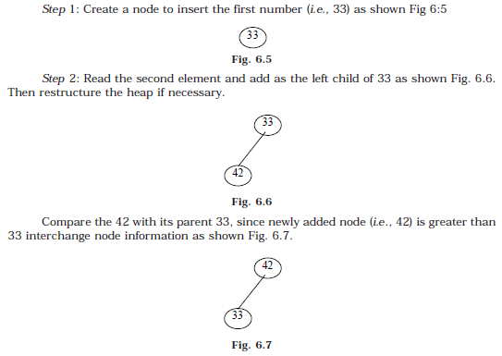

Slide 53
Algorithm
Let H be a heap with n elements stored in the array HA. This procedure will insert a new element data in H. LOC is the present location of the newly added node. And PAR denotes the location of the parent of the newly added node.

Slide 54
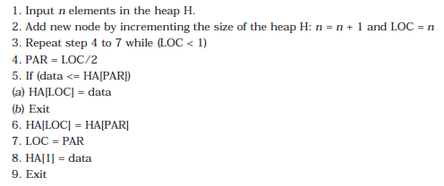
Algorithm for Inserting a node

Slide 55
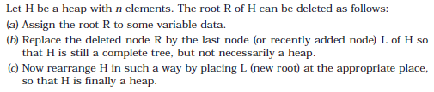
Deleting the Root of a Heap

